Slide 1


Vaccine manufacturer
or UNICEF
EVMA Requirements Framework & Data Inputs
Dan Brigden, WHO HQ
National store
(PR level)
Provincial stores
(SN level)
District stores
(LD level)
Health facilities
(SP level)

Slide 2
EVM Requirements Framework

Slide 3
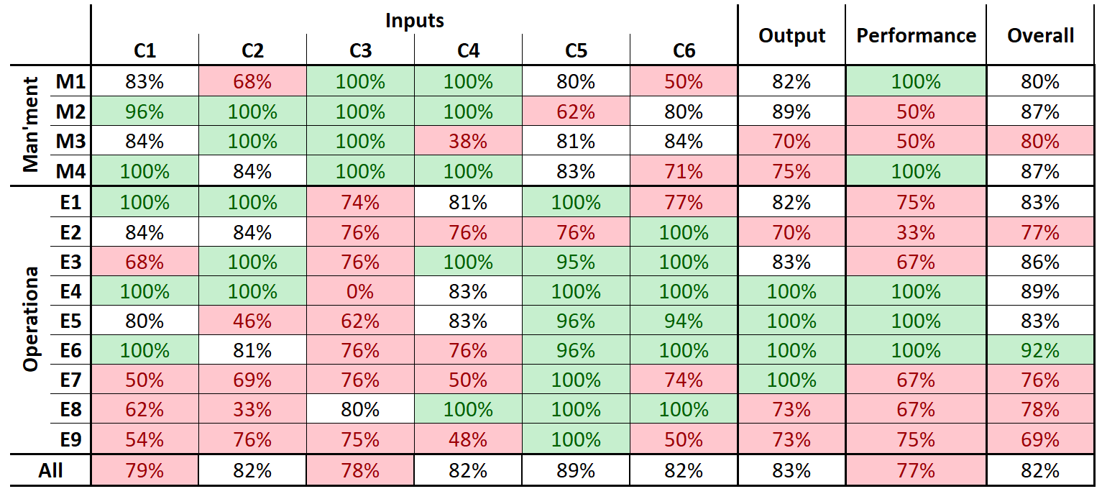
The EVM assessment score matrix (AKA heat-map)

Slide 4
Some background (criteria)
EVM assesses functions, e.g:
temperature management (E2)
stock management (E6)
waste management (E9)
Let’s call these criteria.

Slide 5
EVM assesses the following criteria/functions
Facility operations:
E1 Vaccine arrivals
E2 Temperature management
E3 Storage and transport capacity
E4 Storage of vaccines and dry goods
E5 Maintenance
E6 Stock management
E7 Distribution of vaccines and dry goods
E8 Vaccine management
E9 Waste management
Facility management:
M1 Annual needs forecasting
M2 Annual work planning
M3 Supportive supervision
M4 iSC performance monitoring
Programme management:
SY Immunization supply chain system
ST Strategic planning
R1 Infrastructure management
R2 Equipment management
R3 IT systems management
R4 Human resources management
R5 Knowledge management
R6 Financial resources management

Slide 6
Back to the heat-map

Slide 7
Some background (categories)
All functions (e.g. baking a cake, storing vaccines, making whiskey) require 6 different types of input.
Inputs
Staff
Training
SOPs
Stock record form
Computer
…
Outputs
Stock records are complete, accurate, well organised
Requisition-issue-receipt records are complete, well organised
…
Performance
No stock-outs
All requests met in full and on time
…
Stock management

Slide 8
Some background (categories)
EVM assesses the required inputs, and the expected outputs and performance of those functions (EVM criteria).
Let’s call these categories.
EVM defines minimum requirements (standards) for the inputs, outputs and performance of criteria.

Slide 9
EVM assesses the required inputs, and the expected outputs and performance of criteria
Input categories:
C1 Infrastructure
C2 Equipment
C3 Information technology
C4 Human resources
C5 Policies & procedures
C6 Financial resources
Output:
O Output
Performance:
P Performance
EVM > Criterion > Category > Requirement > Question

Slide 10
EVM input categories and sub-categories
C1 | Infrastructure
C1.1 | Utilities & services
C1.2 | Buildings & facilities
C2 | Equipment
C2.1 | Storage equipment
C2.1.1 | Cold storage equipment
C2.1.2 | Other storage equipment
C2.2 | Transportation equipment
C2.2.1 | Vehicles
C2.2.2 | Insulated containers
C2.3 | Other equipment
C3 | Information technology
C3.1 | General IT equipment
C3.2 | Data management technology
C4 | Human resources
C4.1 | Staffing
C4.2 | Training
C4.3 | Knowledge & understanding
C5 | Policies & procedures
C5.1 | Evidence
C5.2 | Policy & strategy
C5.3 | SOPs
C5.4 | Contracts
C6 | Financial resources
C6.1 | Salaries
C6.2 | Funds for operations
C6.3 | Funds for development

Slide 11
Now you know about the requirements framework

Slide 12
Example: E5 Maintenance & C5 Policies / procedures

Slide 13

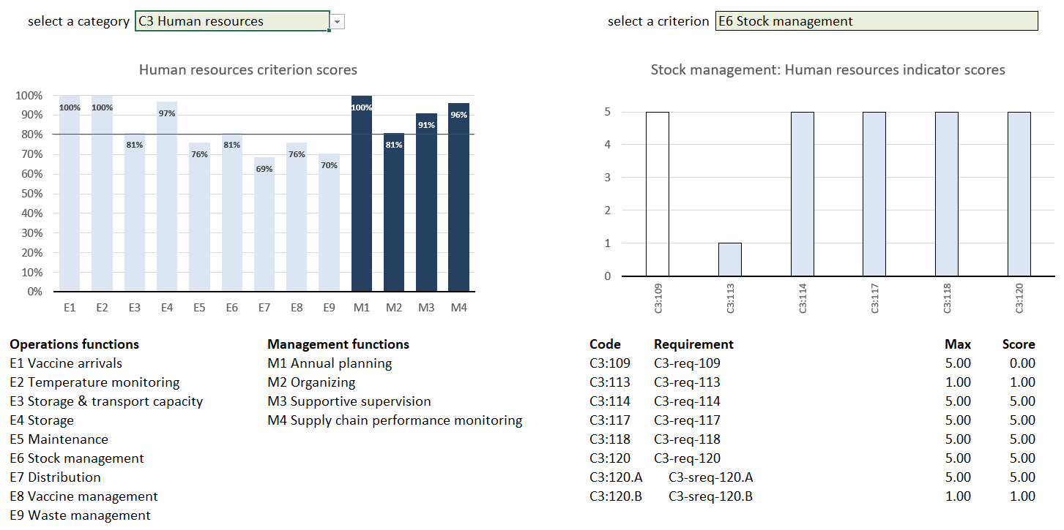
EVMA 2.0 Criterion scores
iSC location functions
EVMA 2.0 iSC PERFORMANCE SCORES

Slide 14
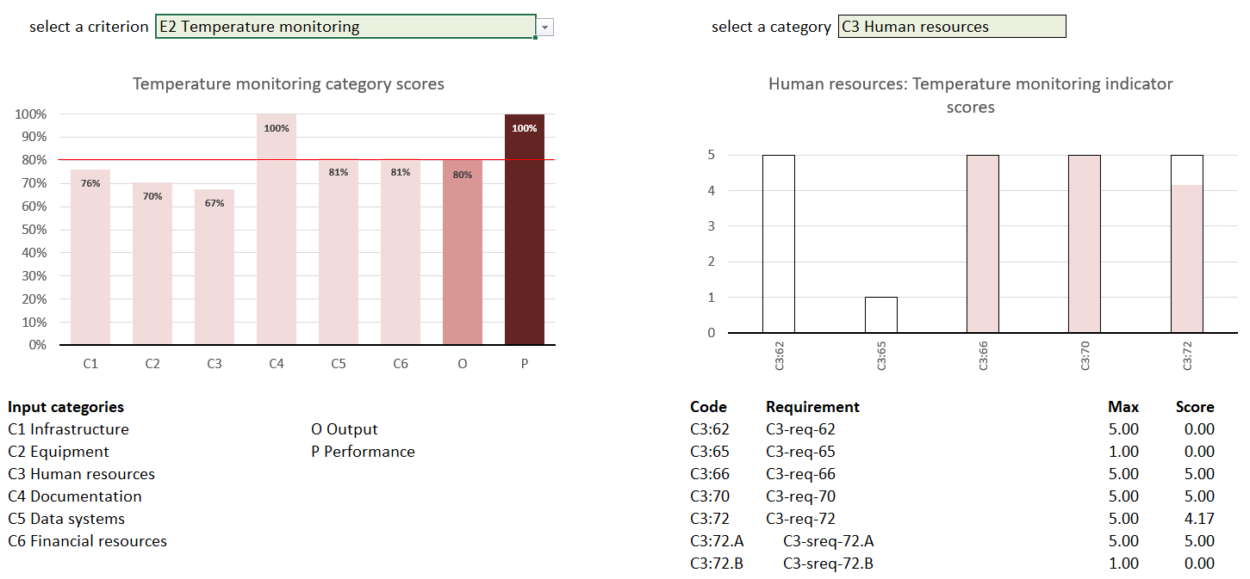
EVMA 2.0 Category scores
iSC location functions
EVMA 2.0 iSC PERFORMANCE SCORES

Slide 15
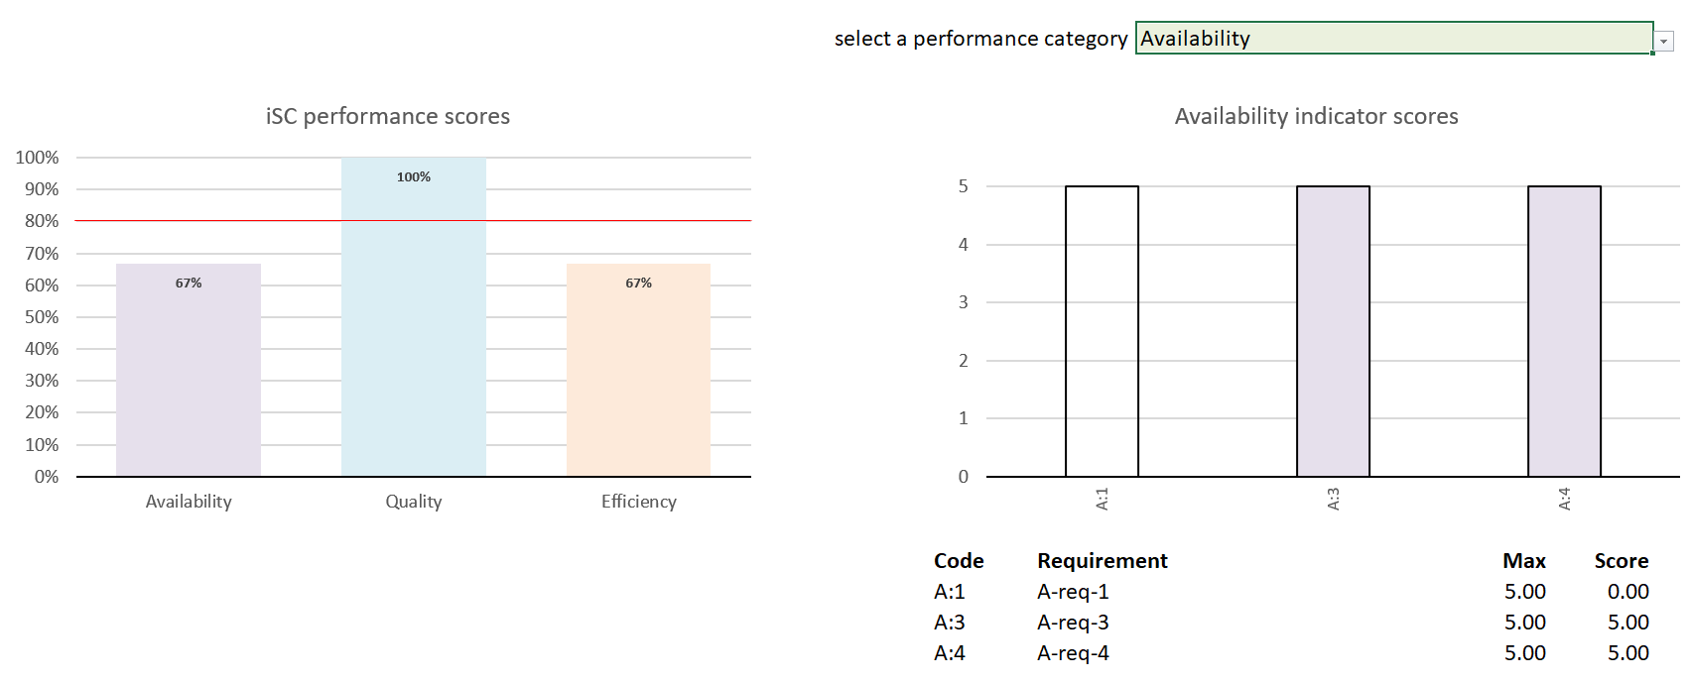
EVMA 2.0 iSC PERFORMANCE SCORES
Five Supply Chain Essentials also

Slide 16
EVM Data Inputs

Slide 17
EVMA ASSESSMENT
An EVM assessment requires 3 data inputs:
COUNTRY SET-UP
DATA COLLECTION
DATA MANAGEMENT
EVM Assessment Manager
(website)
THE ADMINISTRATION TOOL
EVM Locations
(mobile app)
THE DATA-COLLECTION TOOL
EVM Global Dashboard
(website)
GLOBAL DATA ANALYSIS
1
Immunization supply chain system
3
Location questionnaire
2
Program management questionnaire

Slide 18
COUNTRY SET-UP
1
The country manager defines the immunization supply chain system for a particular country. Not used to assess.
S1 Vaccination schedule
S2 Supply chain parameters (nominal supply intervals, safety stocks, …)
S3 Tracer products
S4 Administrative units (state names, districts names, etc, and administrative relationships)
S5 Supply chain locations (vaccine stores and health facilities, and supply chain relationships)

Slide 19
PROGRAM MANAGEMENT QUESTIONNAIRE
2
The country manager and the management staff (e.g. EPI manager, iSC manager) conduct the program management questionnaire.
SY Immunization supply chain system
ST Strategic planning
R1 Infrastructure management
R2 Equipment management
R3 IT systems management
R4 Human resources management
R5 Knowledge management
R6 Financial resources management

Slide 20
LOCATION QUESTIONNAIRES
3
Trained field assessors, normally national staff, fill out location questionnaires to determine if the iSC facility operations and management requirements are met.
The questions are designed to be as objective and simple to answer as possible (most questions are binary, some numerical).
The location questionnaire structure is designed to facilitate quick collection of quality data.
The location questionnaire sections correspond to physical locations or entities, and the recommended completion order follows a logical tour of the location.

Slide 21
LOCATION QUESTIONNAIRES
3
Sections
SOPs
  L18 SOPs
Records
  L18 Standard operations procedures (SOPs)
  L19 Vaccine arrivals
  L20 Temperature management
  L21 Maintenance
  L22 Stock management
  L23 Stock management performance
  L24 Vaccine distribution
  L25 Outreach
  L26 Immunization waste management
  L27 Vaccine needs forecasting
  L28 Annual work planning
  L29 Cold chain equipment inventory
  L30 Vehicle inventory
  L31 Supportive supervision
  L32 ISC performance monitoring
Observation
  L33 Packing insulated containers
  L34 Loading refrigerated vehicles
  L35 Unloading refrigerated vehicles
  L36 Immunization session
Administration
  L1 Assessment details
  L2 Location details
Setup
  L3 Vaccination schedule
  L4 Supply chain parameters
  L5 Tracer products
HR
  L6 Staff
  L7.1 Staff interview 1
Location tour
  L8 Office
  L9 Infrastructure
  L10 Generator
  L11 Vehicle
  L12 Waste management facilities
  L13 Building
  L14 Cold/freezer room
  L15 Refrigerator/freezer
  L16 Storage and transport capacity
  L17 Immunization facilities

Slide 22

Thank you

Slide 23
Annex

Slide 24
A word from Paul
a criterion is a functional area, a set of tasks, nothing else.
by listing the tasks that fall under a criterion, as i have done in the criterion guidance, i am defining the criterion.
a criterion is not "used to assess ...".
a questionnaire section is "used to assess ...".
EVMA 2.0 sets requirements on the inputs, outputs and performance of each functional area/criterion.
an input category is one of 6 pre-defined, function-generic, input categories.
all functions, from washing your hair to running a school, requires these inputs, and nothing more.
consider these like the factors of production in economics (land, capital, technology, labour, knowledge; funds are not considered a factor of production in economics).
by listing the inputs under a category, as i have done in the category guidance, i am defining that category.
this logical structure is implemented in EVMA 2.0.
EVMA 1.0 attempted to do something like this but didn't quite manage. some of the EVMA 1.0 criteria are categories, some of the categories are criteria. some are both.

